Slide 1
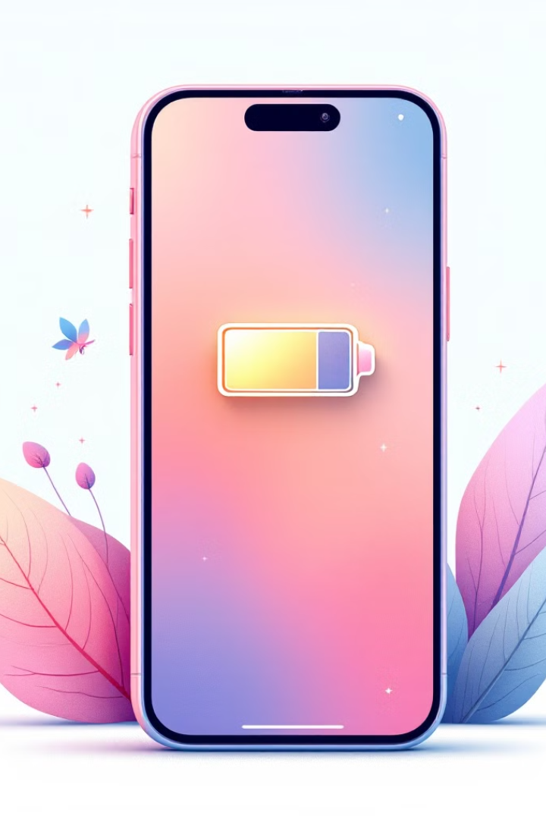

Recharge Your Battery: Self-Care for parents
Supporting children with complex behaviours or behaviours of concern can your emotional and physical energy away. This presentation explores the concept of treating your energy levels like a phone battery, emphasising the importance of self-care for parents and carers. We'll discuss how to identify were your physical and emotional energy is used up within the day, how to recharge effectively, and maintain a healthy balance to provide better support.
“If you want to have enough to give to others, you will need to take care of yourself first. A tree that refuses water and sunlight for itself can’t bear fruit for others. – Emily Maroutian
by Luke Gomersall

Slide 2
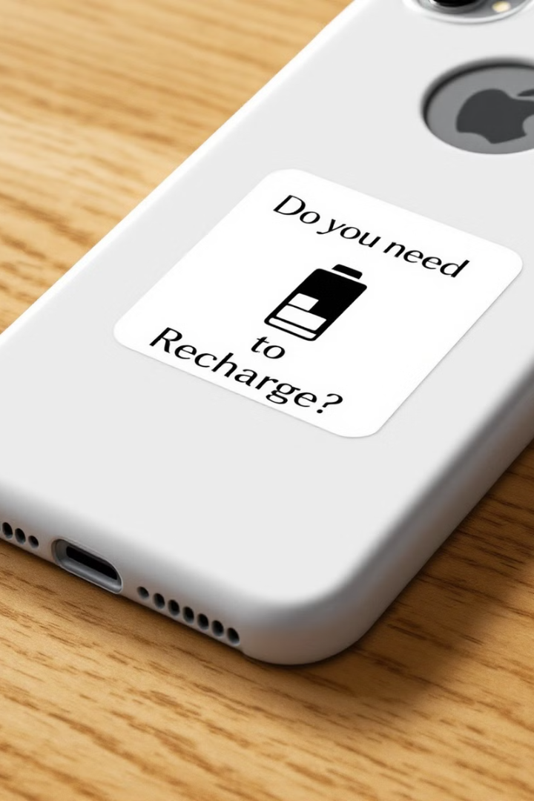
What is the resource?
The resource is a sticker which you put on the back of the phone case, with a picture of a battery saying," Do you need to Recharge? " This question is a reminder to think about your own self-care needs and learn to take breaks in order to be in a position to provide care and support.
Notes:
The concept
Supporting children who has experiencing differing and showing complex behaviours, can be tiring and in order to provide support to other you must first take care of your own need.
The concept, is about looking at your day as if it was your phone battery.
If you watch films and videos on your phone, this uses up a lot your battery and you will need to recharge this. If you don’t use your phone for general day to day use, then this will last throughout the day. It will general get less naturally, but it wont go down in pick chunks.
One your phone battery has gone, this is no good and cant be used, similar to if you use all your social battery in your life, then when something is needed you will not be in a position to support.
In order to know how to recharge, you need to know what take up your energy. In order to this we will use the baskets exercise in NVR and allocate how much of your battery this takes up and how you need to be supported to allow yourself time to recharge.

Slide 3

The Digital Age and Our Dependence
Why I chose a phone case, to add the reminder to ?
12
Minutes
Average time between phone checks for British adults
40
Hours
Time spent online weekly by one-fifth of British adults
64%
Adults
Consider internet connection essential to daily life
We've become a nation attached to our phones, with the average British adult checking their screen every 12 minutes of the waking day (Ofcom,2024). This constant connectivity provides an opportunity to remind ourselves about self-care throughout the day.

Slide 4





Your Day as a Phone Battery
Full Charge
Energy Use
Low Battery
Recharge
Start your day with full energy
Daily tasks drain your battery
Exhaustion leads to ineffective support
Self-care replenishes energy
Just as intensive phone use drains a battery quickly, demanding tasks in your day can deplete your energy. It's crucial to monitor your 'social battery' and recharge when needed to maintain your ability to support others effectively.

Slide 5



Identifying what can take your energy away
Morning Routine
1
40% battery taken away
Work Day
2
50% battery taken away
Evening Routine
3
40% battery taken away
For Example: Understanding what takes your energy is crucial. For example, getting children ready for school might use 40% of your battery, work another 50%, and evening routines an additional 40%. This puts you 30% in the negative, explaining why evenings often feel most challenging and when your experience most of your identified problems. When caring for your children.

Slide 6

Recharge Strategies
Busy families can feel like there is never no time to recharge, what if you can break these down into smaller chunks? Would you benefit from being able to recharge by just 5 or 10%?
5-Minute Breaks
10-Minute Breaks
Cup of tea
Walk around the block
Read 2 pages of a book
Listen to an audiobook
5-minute breath work video
Call a friend
30-Minute Breaks
1-Hour Breaks
Exercise or stretch
Gym session
Grab something to eat
Take a long bath
watch an episode of a programme
Cook a special meal
Family breaks and relationship gestures
Plan a day out
Plan something in house
Plan something with supporters and networks

Slide 7

Optimising Energy Use
1
Identify Problem Areas
Recognise which parts of your day consistently taking energy away from you ?
2
Analyse Causes
Understand why these situations are challenging
3
Implement Solutions
Make changes to reduce energy drain, like waking up earlier or preparing things in advance
4
Evaluate and Adjust
Regularly assess the effectiveness of your changes and make adjustments as needed

Slide 8
Reinforcing Positive Behaviours
Task-Focused Praise
Gradual Independence
Reinforce the action, not the person. For example, say "That was really good how you brushed your teeth" instead of "I am proud of you for brushing your teeth".
Once routines are established, gradually hand responsibilities back to children. This helps build their confidence and reduces your energy expenditure over time.
Remember, as you work on managing your own energy, you're also helping your children develop better habits and routines. This creates a positive cycle that benefits everyone involved.

Slide 9

Key Takeaways
Monitor Your Energy
Prioritise Self-Care
Treat your daily energy like a phone battery, being aware of what takes energy away and recharges you.
Implement regular recharge strategies, from quick 5-minute breaks to longer self-care sessions.
Optimise Routines
Positive Reinforcement
Identify what takes energy away from you and work on optimising your daily routines to conserve energy.
Use task-focused praise and encourage gradual independence to create positive cycles.
By managing your energy effectively, you'll be better equipped to support those who depend on you while maintaining your own well-being.

